Slide 1

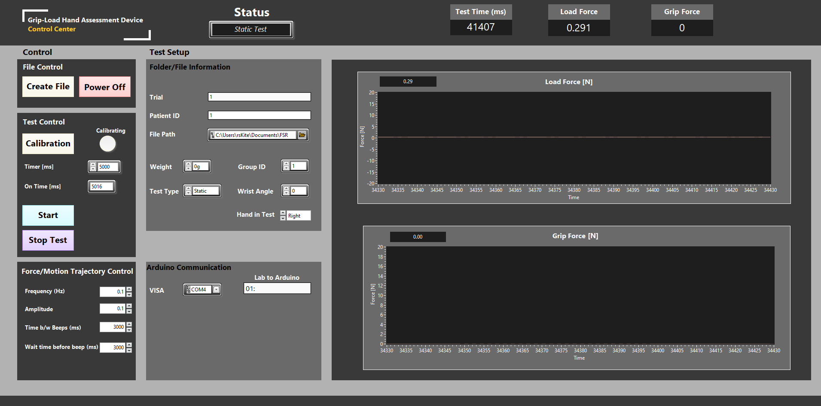

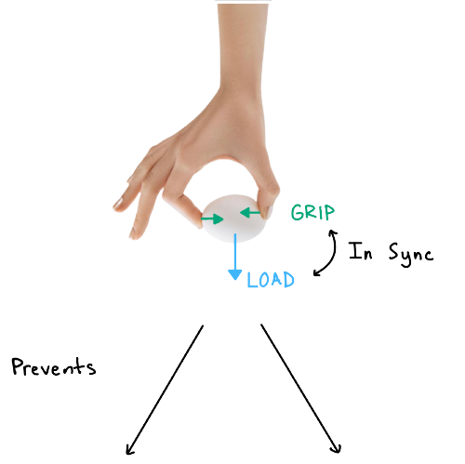
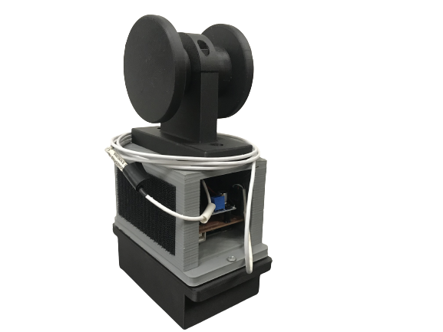
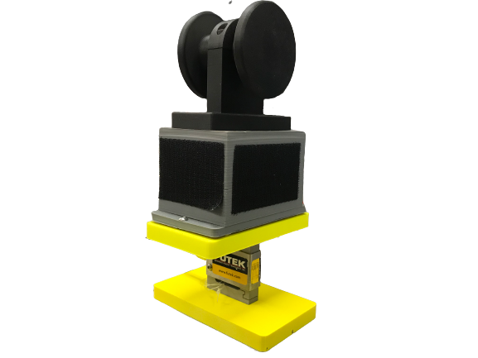

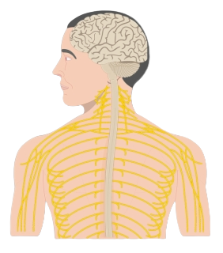
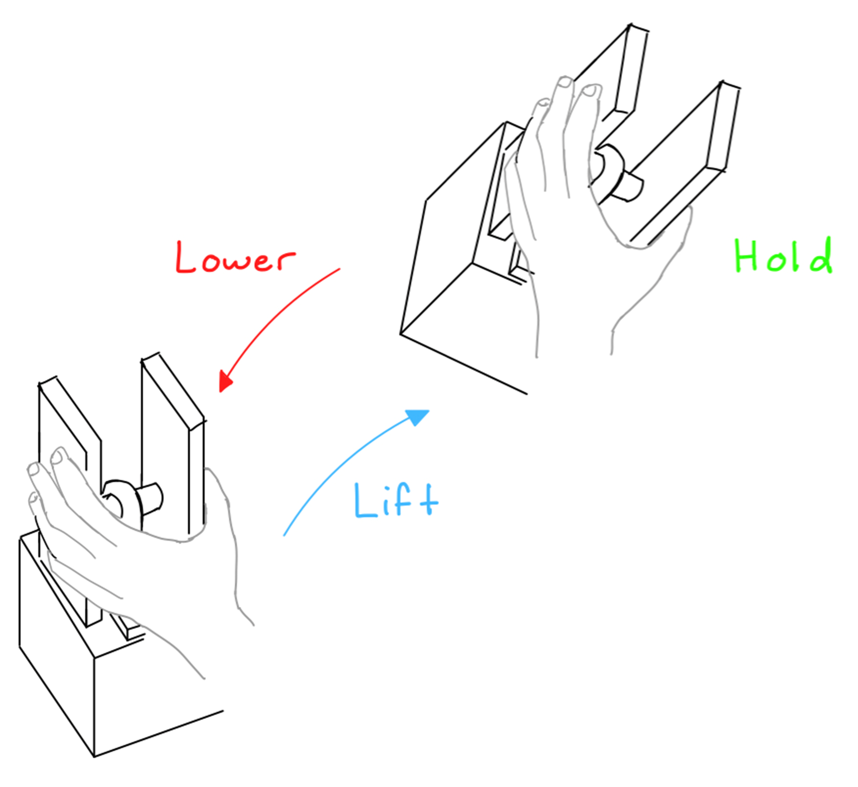
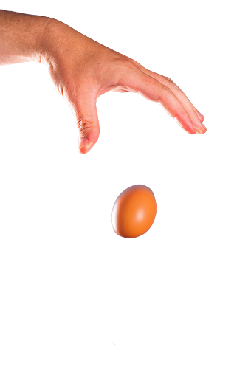
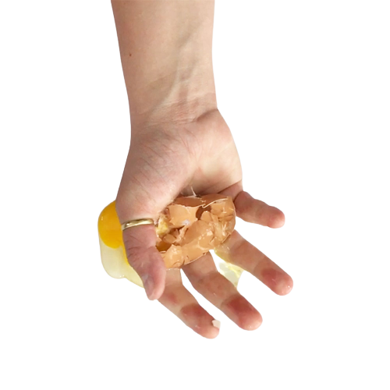

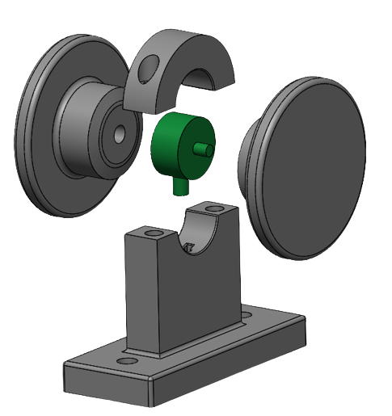
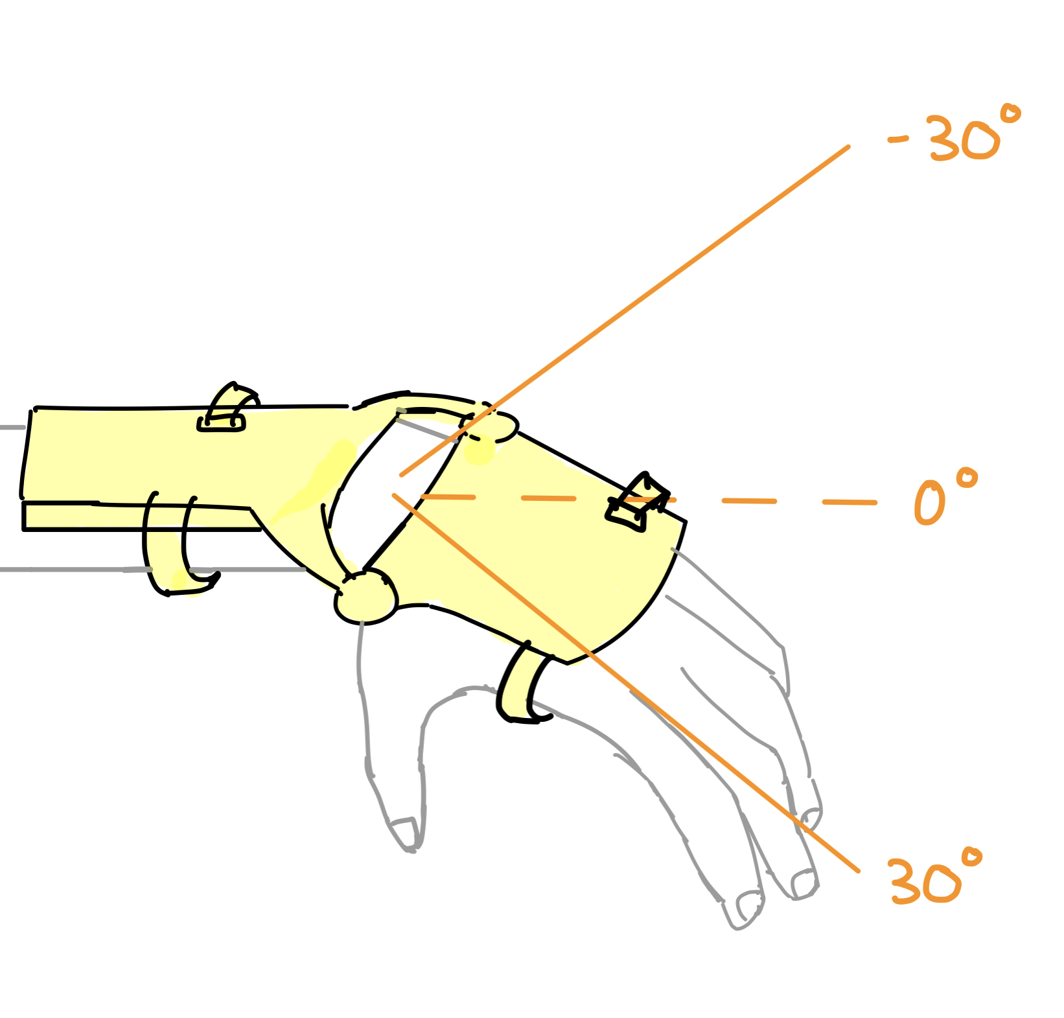
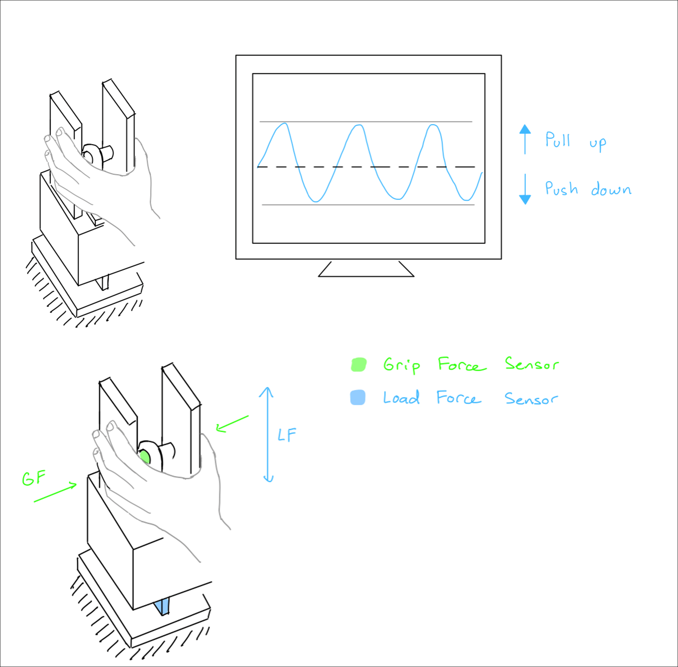
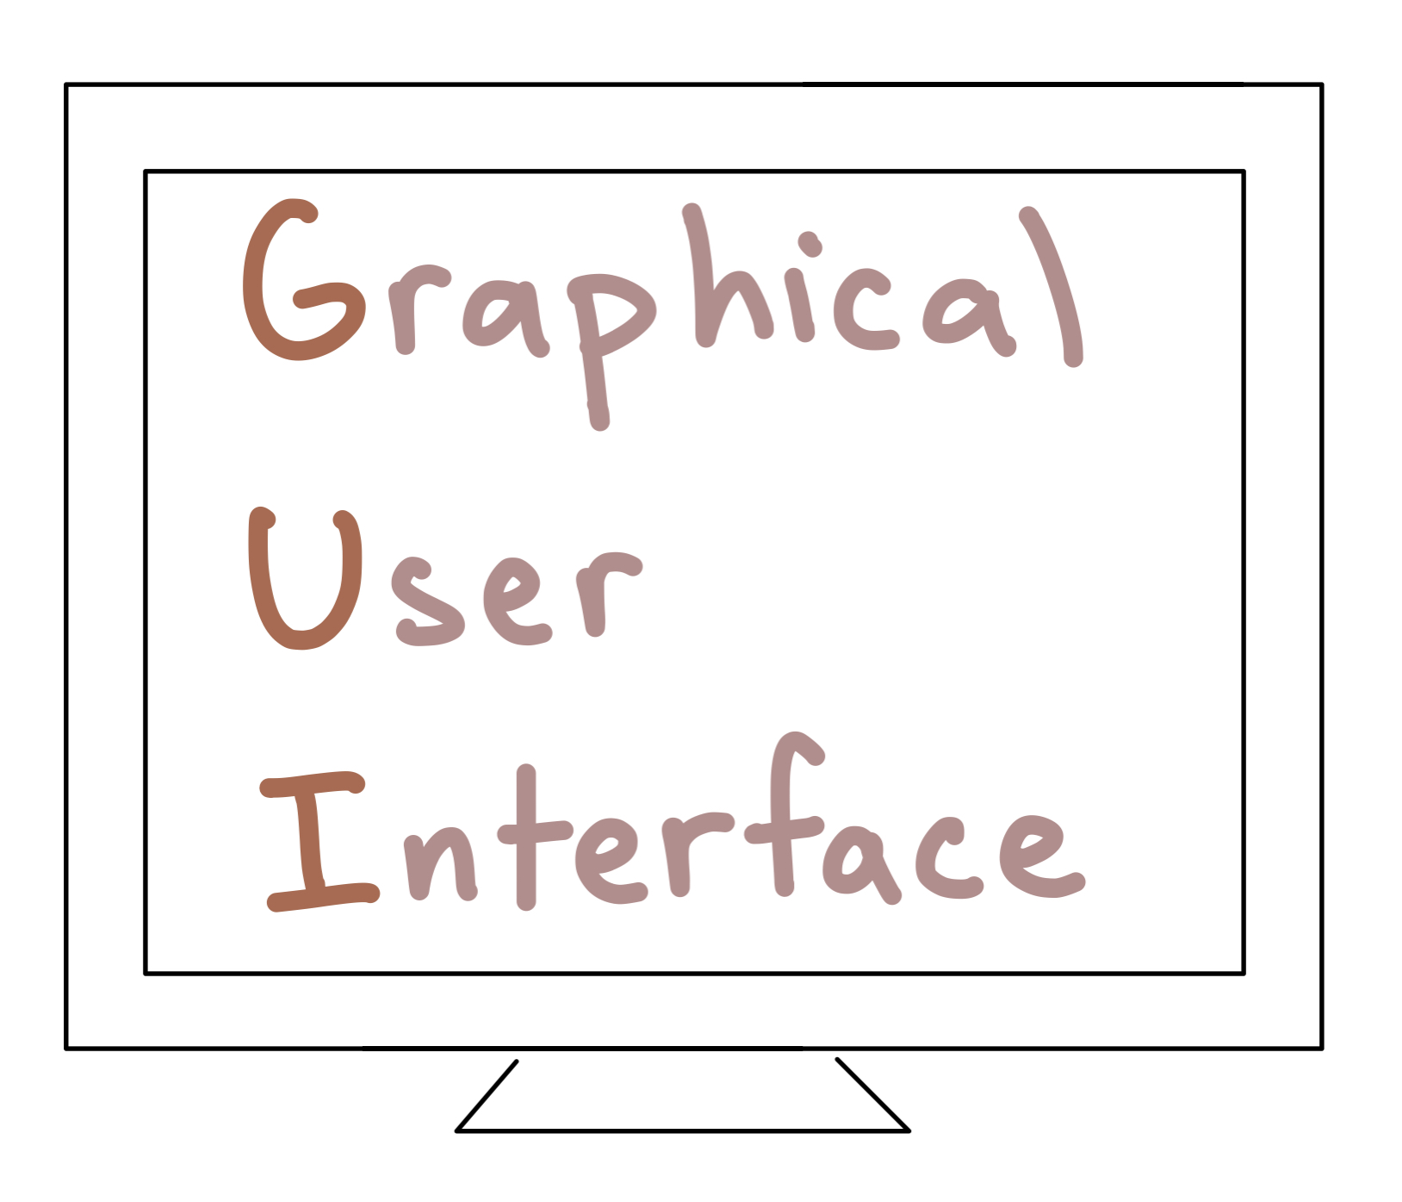
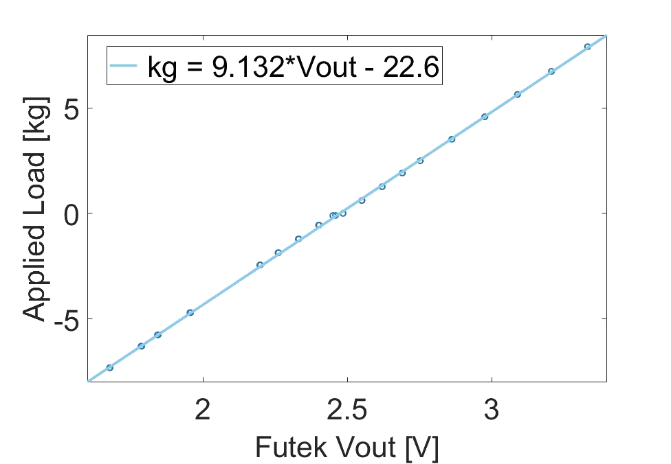
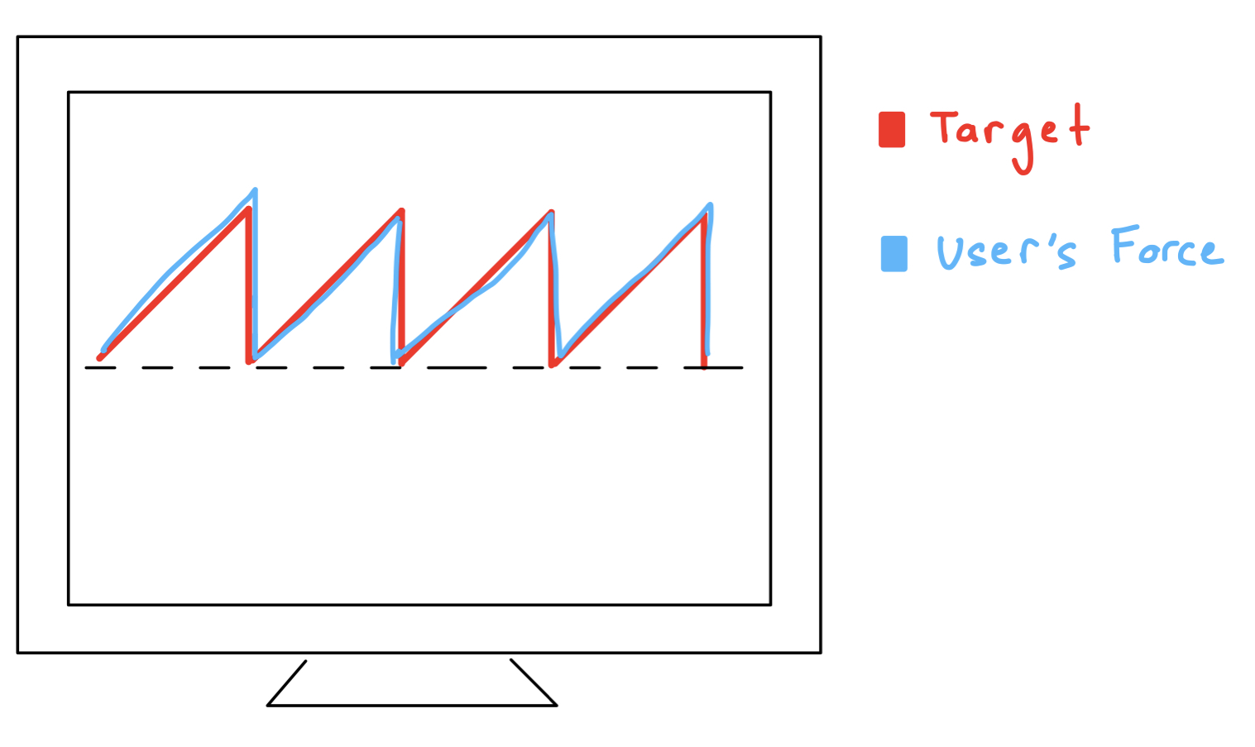
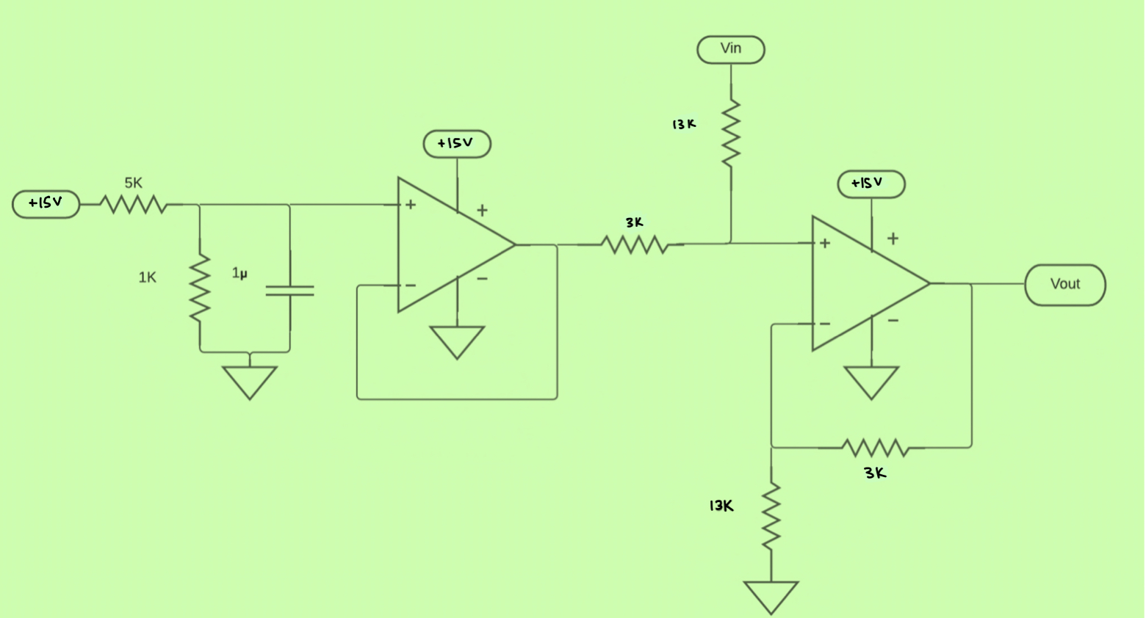
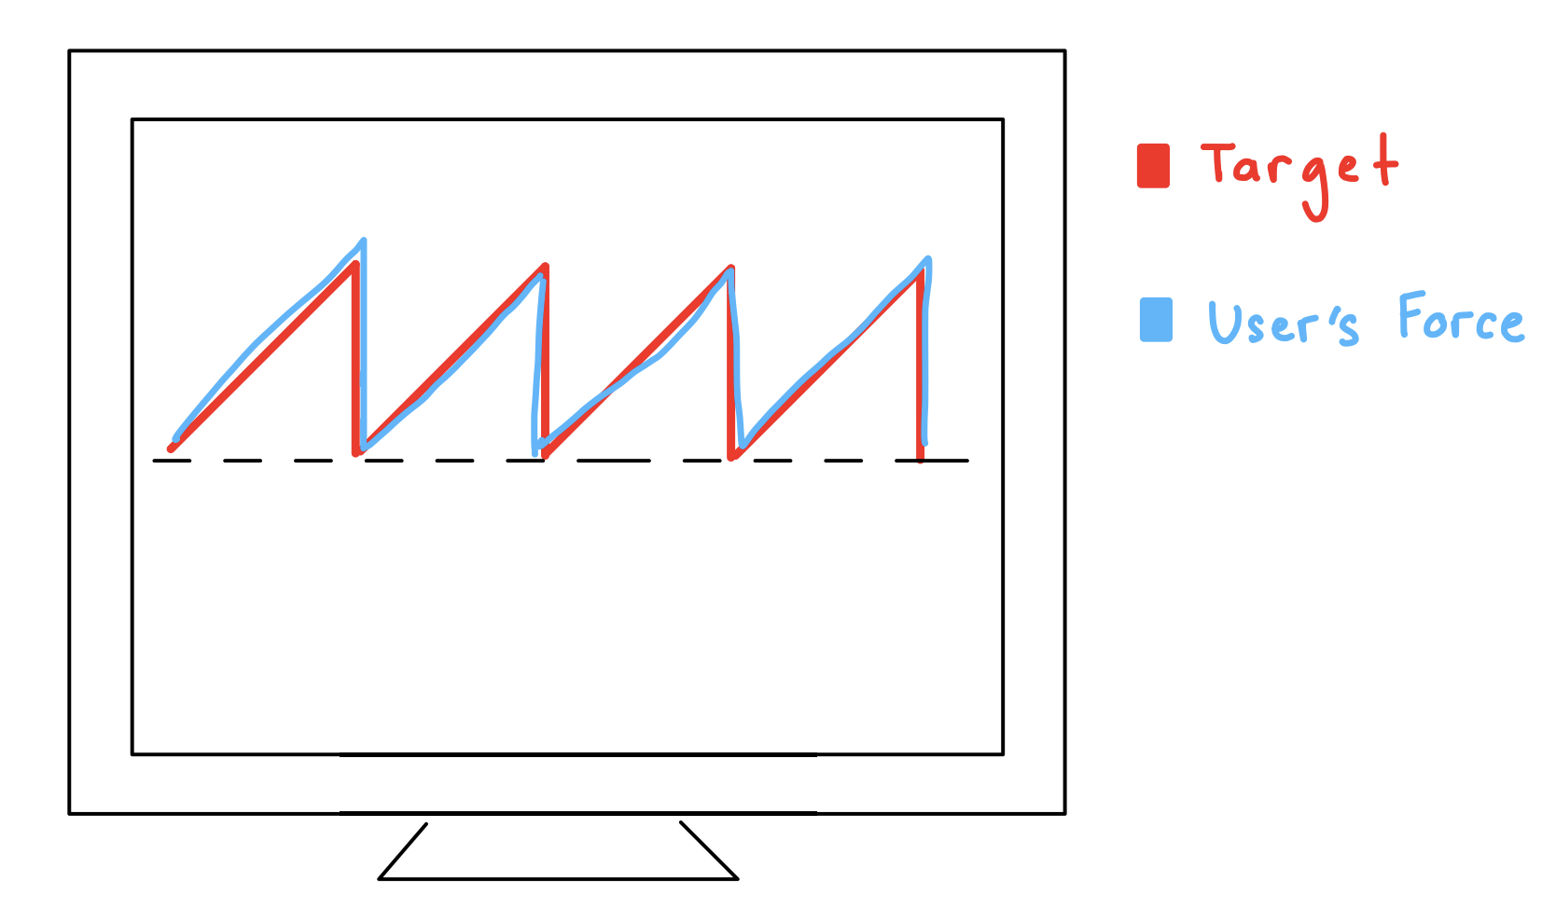
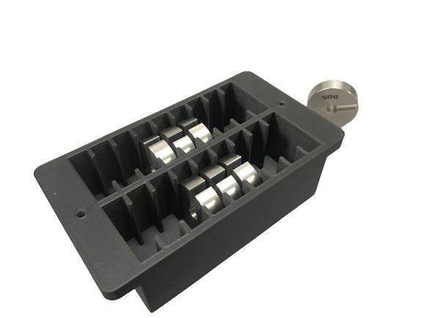
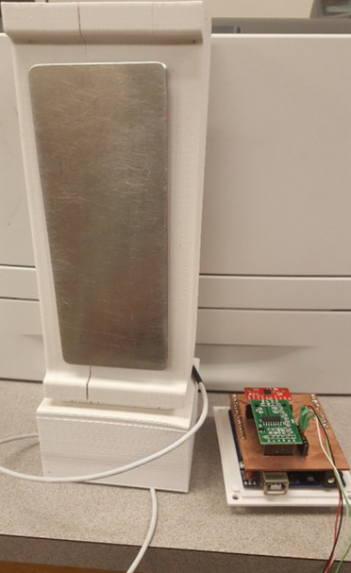
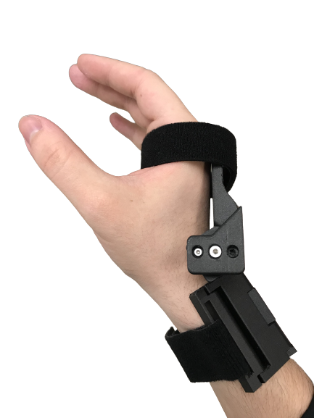
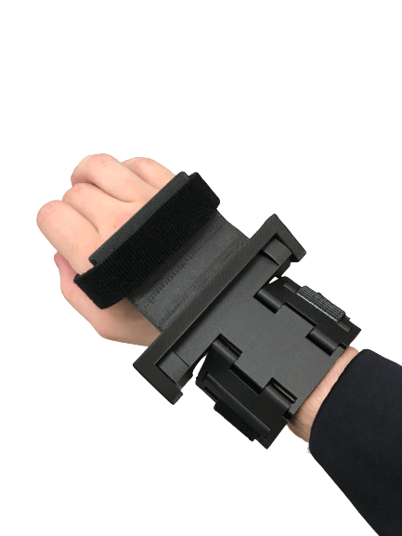

A user interface for evaluating hand force coordination in static and dynamic manipulation tasks
Samid Ceballos¹, Panadda Marayong, Ph.D.¹, I-Hung Khoo, Ph.D.², and Vennila Krishnan, Ph.D., PT³
¹Department of Mechanical and Aerospace Engineering
²Department of Electrical Engineering
³Department of Physical Therapy
Objective
Redesign a hand assessment interface to:
improve force measurement accuracy
provide visual feedback to the user
design an adjustable wrist brace to investigate the effect of wrist angle on grip-load force coordination
Software Redesign
GUI redesigned in LabVIEW
Allows for data collection with Arduino microcontroller
Enables the implementation of visual feedback
Hardware Redesign
Assembled Device Configurations
Grip Force Load Cell Attachment
Collar shaft clamp design
Interchangeable screw on plates to grip device
Futek Sensor Calibration
Calibrated to obtain pushing and pulling forces from voltage
Shifter circuit is used to read voltage values within Arduino
Weight Compartment
Enables increasing the weight of
the device by 50-gram increments
Wrist Brace
Adjustable at 0, 30, and -30 degrees
Enables exploring the effect of wrist
position on grip-load force coordination
Dynamic (Device in Motion)
Accelerometer is used to get Load Force due to gravitational changes
Static (Device is Fixed)
Futek Sensor outputs Load Force
Operator view of the GUI
A
B
Grip Force Sensor
Grip Force Sensor
Planned User Study & Ongoing Work
Dynamic Test
Evaluating grip-load force coordination
User performs a lift-hold-lower
task based on a metronome
Weight of device is increased
Brace is used at the 3 positions
Static Test
Evaluating grip-load force coordination in unidirectional and bidirectional tasks and at 3 wrist positions
User performs a pull and push task based on a metronome
User tracks a ramp force trajectory by pulling on the device
Ongoing Work
Integrating the visual feedback in LabVIEW
Redesigning a circuit board to include shifter circuit
Finalizing the wrist brace design
Visual feedback
Central Nervous System
Electronics Compartment + Accelerometer
Futek Sensor
Haptic feedback
Weight Compartment
C
Shifter circuit
(A) A synchronous coordination of grip force (G; normal to the object contact area) and load force (L; tangential component) is needed to prevent object slippage or breakage (B) Visual and haptic feedback play a key role within the central nervous system to produce efficient manipulation (C) This work redesigns an interface which includes an adjustable brace to explore the effects of wrist position on grip-load force coordination, a device to measure grip and load, and a GUI for visual feedback.
Introduction
Hand impairment is common in elderly over the age of 65 due to neuromuscular disorders and loss of skeletal muscle mass^{[1]}
Previously, a low-cost device was developed to assess grip force vs load force^{[2]}
Post-stroke individuals suffer from hypertonicity
Previous literature has investigated grip-load force coordination in static, dynamic, unidirectional, and bidirectional tasks, but there exists a lack of research investigating the effect of wrist position on grip-load force coordination while a user receives visual feedback ^{[3,4,5]}
References & Acknowledgements
Carmeli, E., et al. “The Aging Hand.” The Journals of Gerontology: Series A, vol. 58, no. 2, 1 Feb. 2003, doi:10.1093/gerona/58.2.m146.
Herrera, D. "Hand Force and Arm Movement Coordination in Static and Dynamic Manipulation Tasks." California State University, Long Beach, 2018. [MS Thesis]
de Freitas PB, Markovic G, Krishnan V, Jaric S. Force coordination in static manipulation: discerning the contribution of muscle synergies and cutaneous afferents. Neurosci Lett. 2008 Mar 28;434(2):234-9. doi: 10.1016/j.neulet.2008.01.067. Epub 2008 Feb 6. PMID: 18313221; PMCID: PMC2323603.
de Freitas, Paulo B., Vennila Krishnan, and Slobodan Jaric. "Force coordination in object manipulation." Journal of Human Kinetics 20.1 (2008): 37-50.
Toma, Simone, Veronica Caputo, and Marco Santello. "Visual feedback of object motion direction influences the timing of grip force modulation during object manipulation." Frontiers in human neuroscience 14 (2020): 198.
This research was supported by the National Institute of General Medical Sciences of the National Institutes of Health under Award Numbers; UL1GM118979; TL4GM118980; RL5GM118978. The content is solely the responsibility of the authors and does not necessarily represent the official views of the National Institutes of Health. The authors would like to thank Daniela Herrera and Ambarish Nayak for initial development of the device.
Grip-Load Device
Top View of 3d printed brace prototype
Side View of 3d printed brace prototype

Slide 2
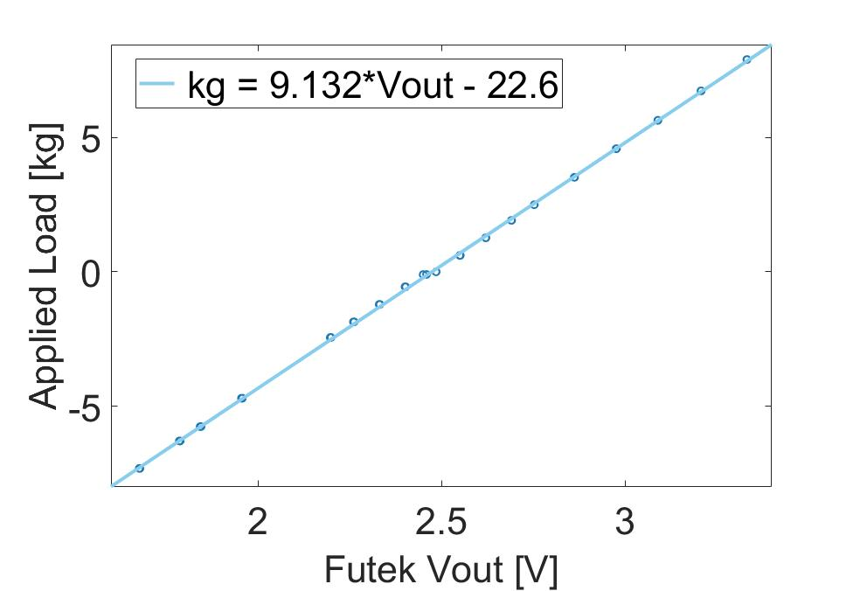
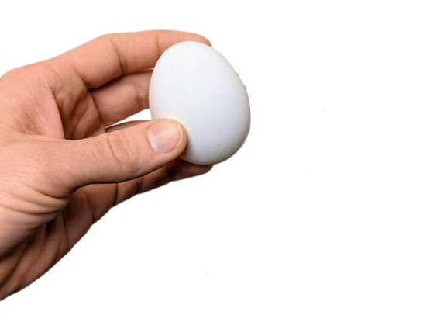
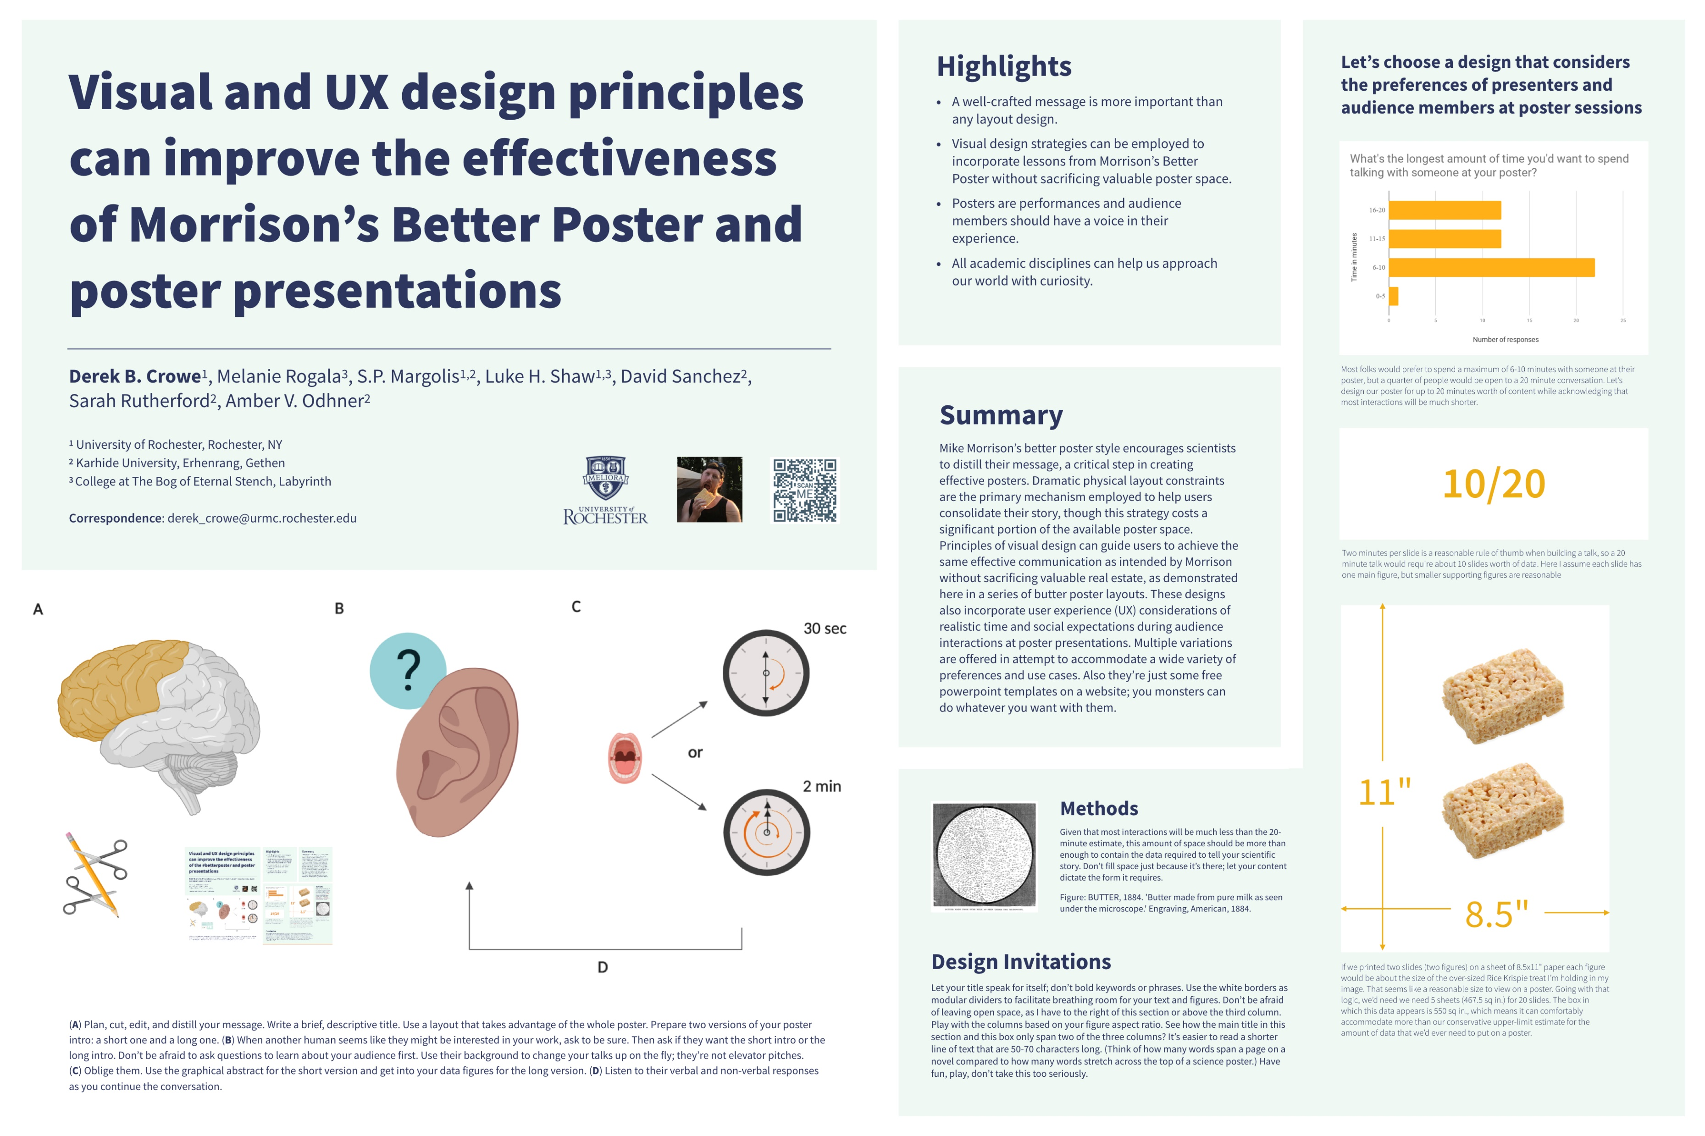
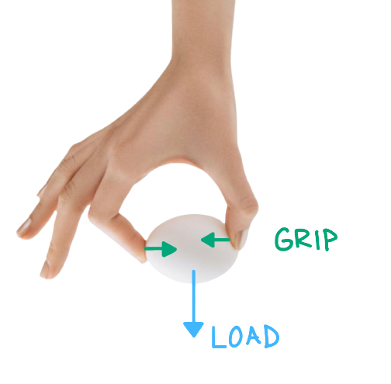

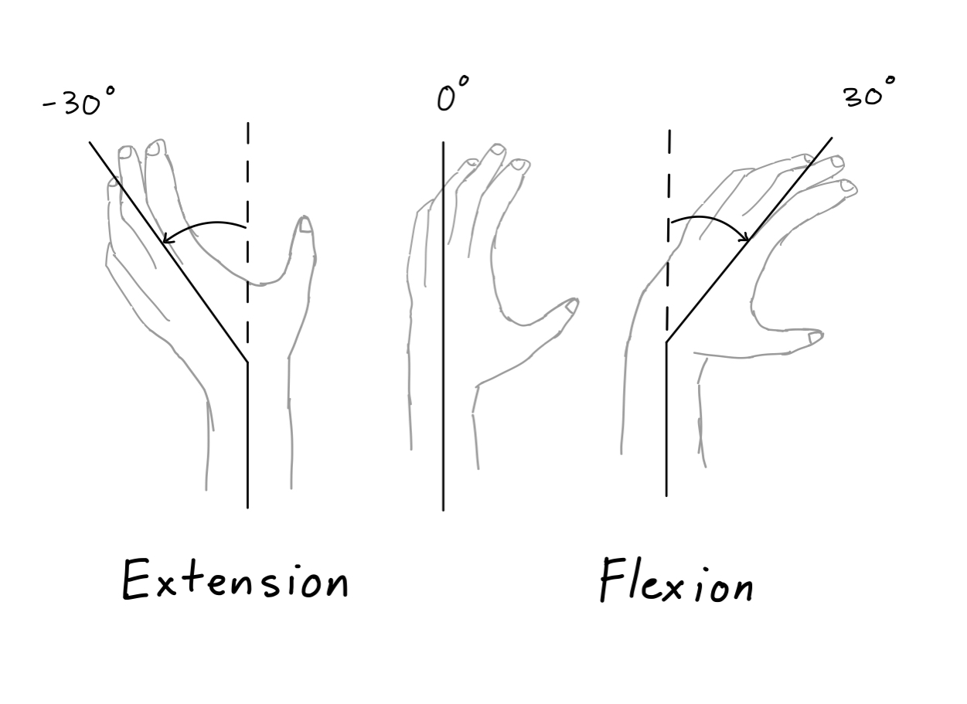
A user interface for evaluating hand force coordination in static and dynamic manipulation tasks
Samid Ceballos¹, Panadda Marayong, Ph.D.¹, and I-Hung Khoo, Ph.D.^{2,} and Vennila Krishnan, Ph.D., PT ³
¹Department of Mechanical and Aerospace Engineering
² Department of Electrical Engineering
³Department of Physical Therapy
Objective
Redesign a hand assessment interface to:
improve sensor readings
provide visual feedback to the user
design an adjustable wrist brace to investigate the effect of wrist angle on Grip-Load coordinate
Software Redesign
GUI redesigned in LabVIEW
Allows for data collection with Arduino microcontroller
Enables the implementation of visual feedback
Hardware Redesign
Grip Force Load Cell Attachment
Collar shaft clamp design
Interchangeable screw on plates to grip device
Futek Sensor Calibration
Calibrated to obtain pushing and pulling forces from voltage
Shifter circuit is used to read voltage values within Arduino
Weight Compartment
Enables increasing the weight of
the device by 50-gram increments
Wrist Brace
Adjustable at 0, 30, and -30 degrees
Enables exploring the effect of wrist
position on grip-load coordination
Assembled Device Configurations
Operator view of the GUI
A
B
Planned User Study And Future Work
Dynamic Test
Evaluating grip-load coordination
User performs a lift, hold, and lower
task based on a metronome
Weight of device is increased
Brace is used at the 3 positions
Static Test
Evaluating grip-load coordination in unidirectional and bidirectional tasks and at 3 wrist positions
User performs a pull and push task based on a metronome
User tracks a ramp force trajectory by pulling on the device
Future Work
Finish integrating the visual feedback in LabVIEW
Redesign circuit board to include shifter circuit
Finalize wrist brace design
Visual feedback
Central Nervous System
Haptic feedback
Shifter circuit
C
Top View of 3d printed brace prototype
Side View of 3d printed brace prototype
(A) A synchronous coordination of grip force (G; normal to the object contact area) and load force (L; tangential component) is needed to prevent object slippage or breakage (B) Visual and haptic feedback play a key role within the central nervous system to produce efficient manipulation (C) This work redesigns an interface which includes an adjustable brace to explore the effects of wrist position on grip-load coordination , a device to measure grip and load, and a GUI for visual feedback.
Dynamic (Device in Motion)
Accelerometer is used to get Load Force due to gravitational changes
Static (Device is Fixed)
Futek Sensor outputs Load Force
Introduction
Hand impairment is common in elderly over the age of 65 due to neuromuscular disorders and loss of skeletal muscle mass^{[1]}
Previously, a low-cost device was developed to assess grip force vs load force^{[2]}
Post-stroke individuals suffer from hypertonicity
Previous literature has investigated grip-load coordination in static, dynamic, unidirectional, and bidirectional tasks, but there exists a lack of research investigating the effect of wrist position on grip-load coordination while a user receives visual feedback ^{[3,4,5]}
Grip Force Sensor
Grip Force Sensor
References
Carmeli, E., et al. “The Aging Hand.” The Journals of Gerontology: Series A, vol. 58, no. 2, 1 Feb. 2003, doi:10.1093/gerona/58.2.m146.
Herrera, D. "Hand Force and Arm Movement Coordination in Static and Dynamic Manipulation Tasks." California State University, Long Beach, 2018. [MS Thesis]
de Freitas PB, Markovic G, Krishnan V, Jaric S. Force coordination in static manipulation: discerning the contribution of muscle synergies and cutaneous afferents. Neurosci Lett. 2008 Mar 28;434(2):234-9. doi: 10.1016/j.neulet.2008.01.067. Epub 2008 Feb 6. PMID: 18313221; PMCID: PMC2323603.
de Freitas, Paulo B., Vennila Krishnan, and Slobodan Jaric. "Force coordination in object manipulation." Journal of Human Kinetics 20.1 (2008): 37-50.
Toma, Simone, Veronica Caputo, and Marco Santello. "Visual feedback of object motion direction influences the timing of grip force modulation during object manipulation." Frontiers in human neuroscience 14 (2020): 198.
Electronics Compartment + Accelerometer
Futek Sensor
Grip-Load Device
Weight Compartment

